Slide 1

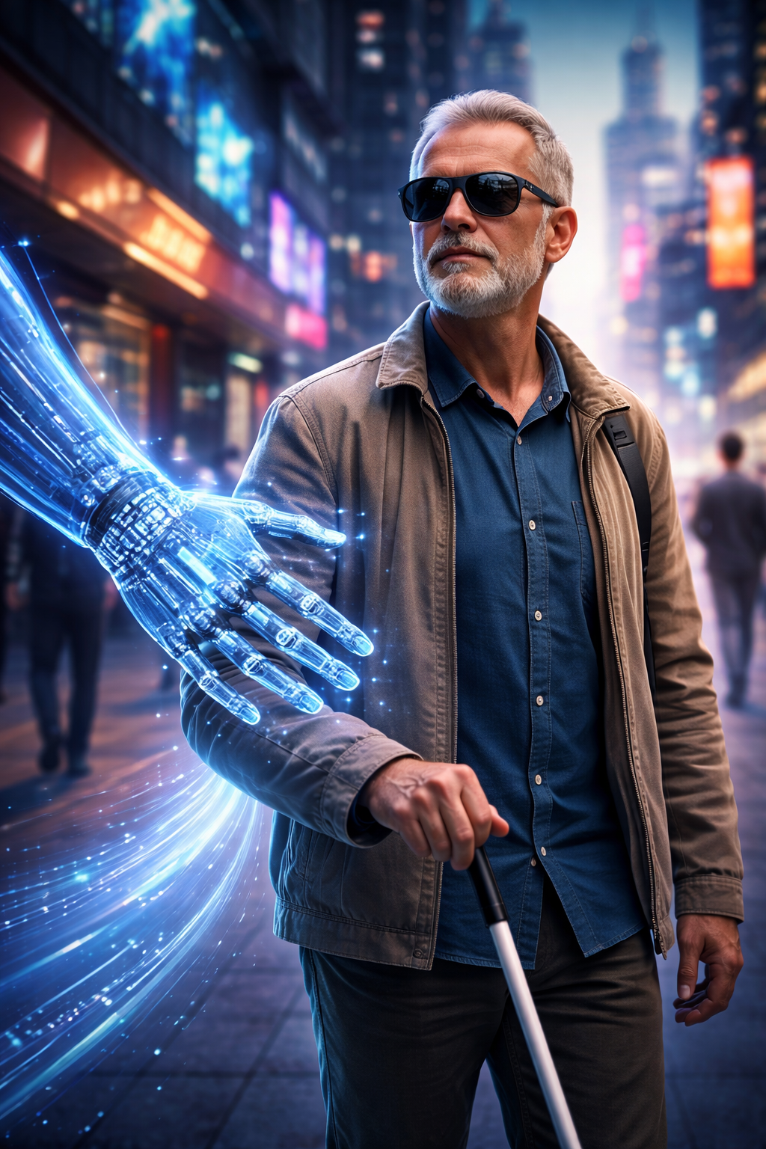
AI Assistant
for Visually Impaired People
Guardian
Eye

Slide 2


Vision assistance
Introduction to GuardianEye Project
Guardian Eye is an AI-powered assistant designed to improve independence and safety for visually impaired users. It combines computer vision, text understanding, speech interaction, and mobile guidance in one accessible workflow.
24/7
AI ACCESS
AI-powered navigation and scene understanding
The project helps users understand their surroundings, read printed text, ask questions about objects, and receive spoken feedback in real time. The goal is to turn a smartphone into a practical daily assistant for movement, reading, and decision support.

Slide 3

Guardian Eye
ProblemDefinition
Visually impaired people often face barriers when identifying objects, reading labels, navigating unfamiliar places, and reacting quickly to obstacles. Daily tasks that sighted users perform in seconds may require assistance, extra time, or risky guesswork.
Existing tools usually solve one task only, such as reading text or detecting objects, but they do not provide a complete assistive experience. Our project addresses this gap by combining perception, reasoning, and voice interaction in a single mobile system.

Slide 4

Guardian Eye
System Architectureof Guardian Eye
The architecture follows a multimodal pipeline where visual data and voice commands are processed by specialized AI modules, then fused into simple spoken feedback that the user can act on immediately.
Mobile Camera Input - captures the live scene continuously
YOLO Detection - recognizes objects, hazards, and scene elements
Speech Modules - converts voice commands to text and answers back
Preprocessing Layer - frames and images are prepared for analysis
OCR + LLM - extracts text and explains it in useful language
Mobile App Output - delivers alerts, descriptions, and guidance

Slide 5


Guardian Eye
Obstacle awareness to warn users about hazards in front of them
AI Models: YOLO
Spatial context by estimating where objects appear in the frame
Fast inference suitable for mobile-friendly assistive scenarios
Real-time object detection for doors, chairs, cars, stairs, and people
High-value alerts focused on immediate safety and navigation

Slide 6

Guardian Eye
From text extraction to smart explanation
OCR + LLM for Readingand Understanding
This module goes beyond text recognition. After OCR reads the visible content, the language model can explain what it means, answer follow-up questions, and present the result in a way that is easier to understand through audio.
OCR extracts printed text from labels, signs, documents, and medicine boxes
LLM summarizes complex content into short, useful spoken answers
Text can be translated, explained, or converted into task-oriented guidance
Context-aware responses help the user understand meaning, not only raw text
Multi-step reading support for menus, instructions, and forms

Slide 7
Guardian Eye
Speech Interaction & Audio Output
Designed for smooth two-way communication
Speech recognition captures user commands without touching the screen
Voice prompts make the app easier to use while walking or multitaskingText-to-speech returns descriptions, warnings, and answers clearly
Hands-free interaction improves accessibility and comfort
Natural dialogue allows users to ask follow-up questions in real timeSpeech interaction is essential for accessibility because it removes dependence on visual menus. Users can ask the app what is ahead, request text reading, and receive immediate verbal feedback tailored to the scene.

Slide 8


for Accessibility
Challenges in AI
Building assistive AI means solving more than accuracy. The system must also remain fast, understandable, and reliable enough to support real users during everyday movement and reading tasks.
Guardian Eye
Lighting changes, blur, and camera angle can reduce detection quality in real environments.Text recognition becomes harder on curved surfaces, small labels, or low-contrast packaging.
Speech recognition may struggle in noisy streets or crowded public places.
Latency must stay low so spoken guidance remains helpful and safe.
Model accuracy and battery efficiency must be balanced for mobile deployment.
User trust depends on consistency, clarity, and low delay.

Slide 9
AI Demo | Scene Walkthrough | Guardian Eye | 1. User points the camera toward the environment
2. YOLO detects nearby objects and hazards | 3. OCR reads visible text such as signs or labels | 4. LLM explains the result in simple language | 5. Speech output tells the user what to do next
6. User can ask follow-up questions by voice | The demo shows how the AI pipeline works as one experience instead of separate features. From a single camera view, the app detects objects, reads text, interprets meaning, and answers through audio in a few seconds. | A complete assistive AI flow from vision to action

Slide 10



Guardian Eye
Software Development
Mobile App Frontend
Backend and AI Integration
Testing and Iteration
Flutter / accessible UI design
Model serving and API communication
Usability feedback with assistive scenarios

Slide 11

Feature
App DemoScreensand ResultsOverview
What the user experiences | Value | 1
Object detection | Real-time spoken alerts about obstacles and nearby items | 2
Text reading | Reads signs, labels, and short documents aloud | 3
Question answering | Explains the scene or extracted text using natural language | 4
Voice control | Lets the user interact without needing visual navigation | 5
Safety support | Improves confidence during movement and daily tasks

Slide 12



Guardian Eye
The ImpactTodayof Guardian Eye
Independence
Improves access to printed information and signs
The project is designed to improve independence, reduce reliance on constant assistance, and make everyday information more accessible for visually impaired users.
Safety
Supports safer navigation in unfamiliar places
AI & Access
Creates a more natural, voice-first assistive experience

Slide 13
Guardian Eye
Future Work in Guardian Eye
Future improvements include better distance estimation, offline inference for faster response, multilingual voice support, and personalized alerts based on user preference and environment.
Another next step is broader testing with real users to refine accuracy, phrasing, and trust. The strongest assistive systems are built not only with AI models, but with repeated feedback from the people who depend on them.

Slide 14
Guardian Eye
Conclusion
Guardian Eye combines computer vision, language understanding, and speech interaction into one assistive platform.
By merging multiple AI capabilities in a simple mobile experience, the system can make daily life safer, faster, and more independent for visually impaired people.
The project focuses on practical tasks such as detecting objects, reading text, and guiding the user through spoken feedback.

Slide 15






Guardian Eye
Thank You
+20 000 000 0000
guardianeye.ai
@guardianeye
AI Accessibility Project, Cairo
Egypt
AI for visually impaired people should be accurate, simple, and human-centered. Thank you for your time and attention.

